Slide 1




















VEGGIE
MART
Bringing Fresh local Produce to your Doorstep

Slide 2


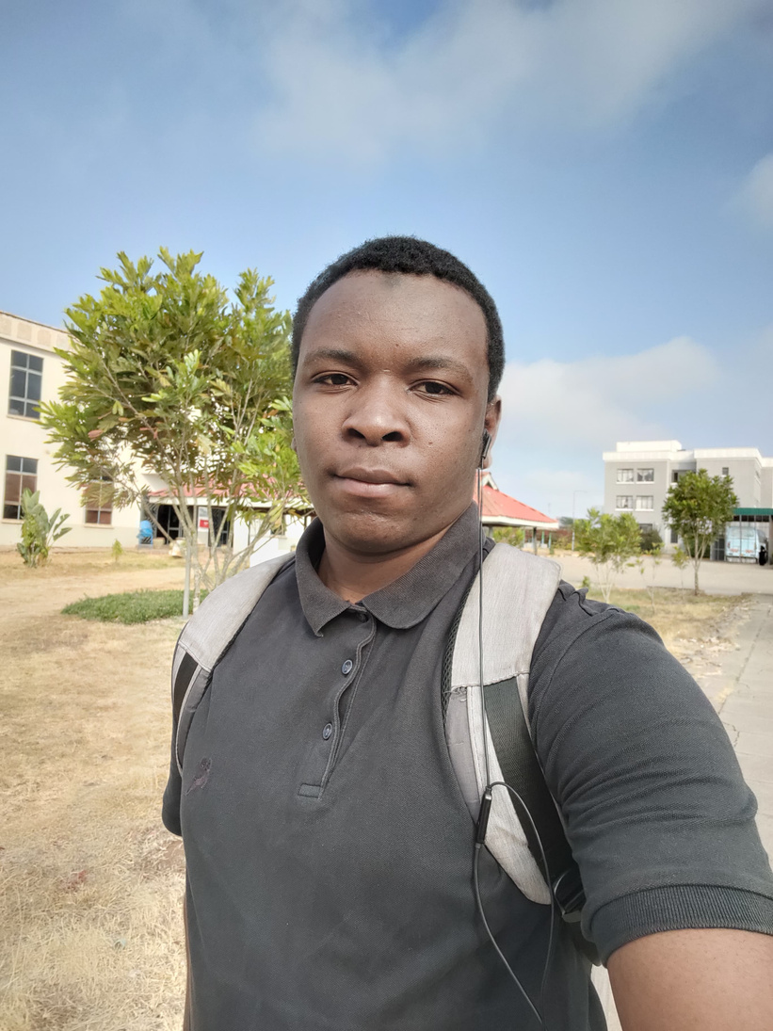


HELLO, EVERYONE!
I am Zaid Mohammed, The sole Developer for this project

Slide 3

ABOUT
VeggieMart is an online platform that connects consumers with local farmers, making fresh produce accessible to urban areas
Its Mission is to streamline the process of selling locally produces goods specifically fresh farm produce and support small scale farmers
VeggieMarts Key Features Entails:
A catalogue of Fresh Produce Updated Daily
Seamless Payment using Mpesa
Intuitive ordering Process
Delivery Tracking in real time

Slide 4






LEARNING OBJECTIVES
Master intergration of Backend with front-end
Farmiliarizing myself with the process of creating RESTfulAPI’s
User Authentication
Implementing thirdparty payment Systems

Slide 5



TECHNOLOGIES
BackEnd: Node.Js,Express.Js
FrontEnd:HTML,CSS,JavaScript
Frameworks:Bootstrap
Database:MongoDB
API Testing: PostMan
Deployment: Heroku

Slide 6


THIRD PARTY SERVICES
Payment Integration: Mpesa
Secure and fast mobile payment system for transactions
It is the most widely used and trusted payment method in Kenya
Email Services: Mailgun
Automated email confirmations and successful orders and delivery updates
Ensuring customers stay updated through out the purchasing and delivery process
Maps Integration: GoogleMaps API’s
Location tracking for delivery Services
Realtime Route Optimization

Slide 7




CHALLENGES
Ensuring Seamless Mpesa Payment integration across different devices
Handling dynamic inventory of perishable goods in Realtime
Implementing a reliable delivery tracking system

Slide 8


SCHEDULE
WEEK 1 DAY (1-7)
Day (1-7) : Finalizing Project plan and setting up the front end and backend
WEEK 2
Day (8-14) Building The different plattform modules
WEEK 3
Day (15-21) Endpoint testing and third-party integration
WEEK 4
Day (22-27) UI/UX Refinement, User Testing and Feedback, Bug Fixes and Deployment

Slide 9
THANK YOU FOR WATCHING!
Feel free to reach out to us through any of the following:
GITHUB:
EMAIL:
github.com/zaidsaid-007
zaidsaid007@gmail.com
LinkedIn:
@Zaid Mohammed

